Slide 2
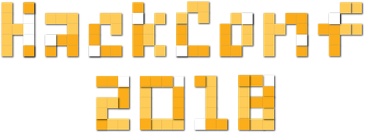
Parallel Programming & high performance computing
BLAGOVEST TASKOV

Slide 3
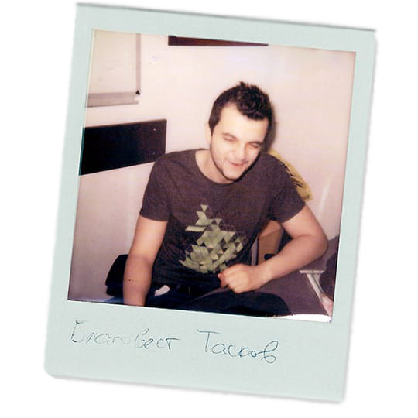
Blagovest Taskov
In Chaos Group for 6+ years
V-Ray GPU Developer for 4+ years
Lead V-Ray GPU Developer for 2+ years
Game industry
@savage309
High Performance Computing in Faculty of Mathematics and Informatics in Sofia University
Held “every other year”.
github.com/savage309/HPC_FMI

Slide 4






Slide 5


Slide 6


Slide 7
Who is this talk for?
Talk is technical, without going too deep
Mostly for university and high school students that have some interest in programming
I assume that you already are somewhat familiar with programming
Javascript/Python/Go are cool
To make something really cool though, you need as much performance as you can possibly get
Who is this talk NOT for?
Not much for experts, as there are no novel stuff
Just in case – this talk has nothing to do with V-Ray GPU

Slide 8
START WITH THE WHY*
Never blindly follow the rules
The rules are the status quo
Have an intuition and understanding for what you are doing
This is way more important
Know why you have to do something, not how to do it
Everybody can memorize which button to click when
WHY
HOW
WHAT
*SIMON SINEK
Notes:
starts at <5 minute
before i go in the details of the talk, i want to quickly mention something
and this is the importance of the answer of the question why
It is easy to learn WHAT should be done in case something happens. For example, you should add an if check in case of NULL pointer crash
It is easy to learn HOW to make something generally work. For example, you can learn which button to press when in order to make something. In the case of nullptr, you can pretty easily learn how to add an if statement.
But the most important of all is WHY something happens. WHY is by far the most important question - if you know why something happens, you can figure out how to approach it and what to do when. The other way around is not true.
So, if nothing else, the most important thing that you can remember from the talk is - if you do something, without knowing why, you are not doing it correct.
Never blindly follow the rules. Always question everything

Slide 9
Discriminant
Why we compute it the way we do? What's the intuition behind it?
Can you invent it yourself?
Determinant
Why we compute it the way we do? What's the intuition behind it?
Can you invent it yourself?
If you can’t answer these questions, but remember the formulas to compute them, the best you can do is to pass your math exam
This is still not bad, but it is not ideal
WHY
HOW
WHAT

Slide 10


Slide 11
WHY?

Slide 12
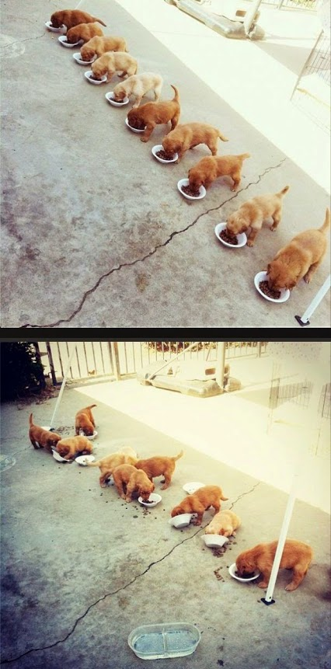
WHY WE NEED PARALLEL PROGRAMMING
We will go into this in details, as it is important
Short answer: no matter how fast the computer, people will always need faster
Toy Story rendered in 1995, >4 hours per frame
Using a computer *much* slower than your phone
VFX movies in 2018, >4 hours per frame
Blinns law / the paradox of the performance – no matter how fast computers you have, production rendering will always take N hours
Notes:
<9 minute

Slide 13
Improving the Facebook PHP JIT Compiler by 1% translates in many years of salary for our best paid engineers
Andrei Alexandrescu

Slide 14
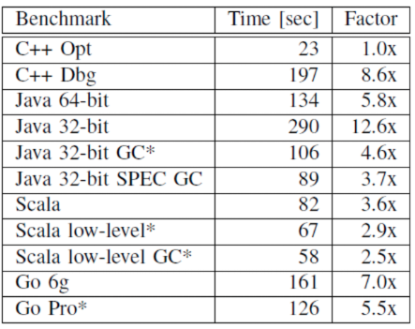
CHANCES ARE, YOUR APP WILL RUN ON A MOBILE DEVICE, IN A CLOUD OR WILL BE VERY PERFORMANCE DEPENDENT
All of these requires the most performance possible
”In regards of performance, C++ wins out by a large margin”
5.8 times faster compared to Java
7 times faster compared to Go
”Loop Recognition in C++/Java/Go/Scala”, Hundt, Google.

Slide 15
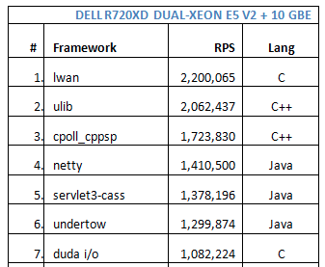
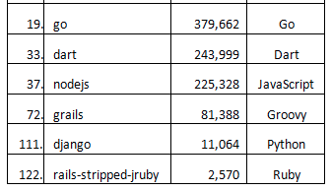

Slide 16
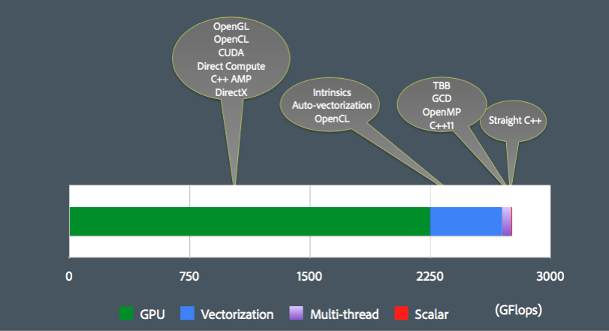
DOMAIN
Mobile applications
Weather / Financial / Bio / Chemistry simulations
Games
Photorealistic rendering
VR/AR
Automotive
Robots
AI
Much more
Sean Parent (CPP CON 2015)
Notes:
13m

Slide 17
Performance = Parallelism
Efficiency = Locality
Notes:
~13

Slide 18

THERE ARE THREE WAYS TO GET MORE PERFORMANCE
Work harder
Work smarter
Get help
This is true not only for computing, but for everything in life.

Slide 19
THERE ARE THREE WAYS TO GET MORE PERFORMANCE
Work harder - Increase CPU frequency - Power Wall
Work smarter - ILP, cache, branch prediction - Memory wall
Get help – More cores - Works (kinda)

Slide 20
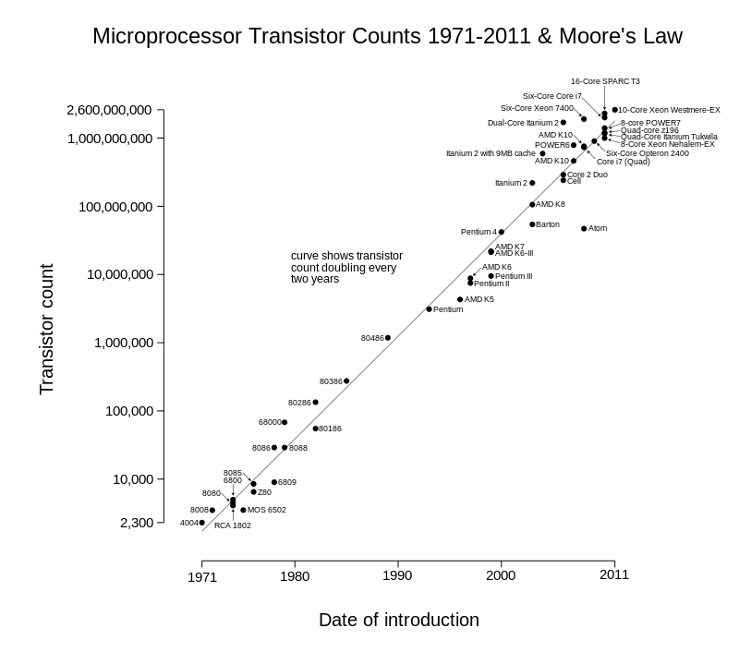
Notes:
< 17m

Slide 21
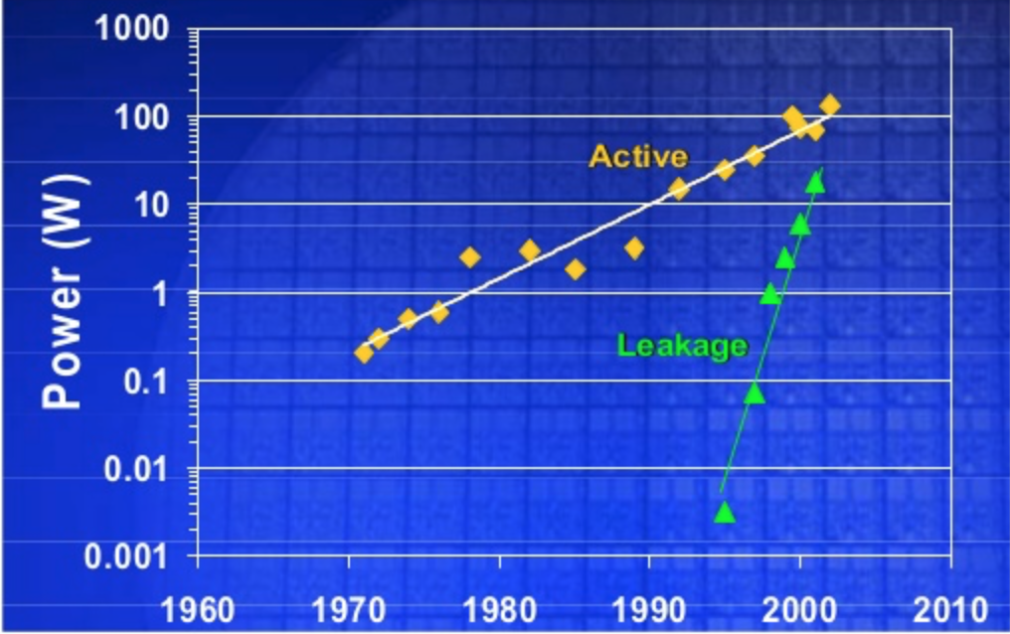
Frequency (f) ~ ((V - Vth)ª) / V
Power = Dynamic Power + Static Power Dynamic Power (energy needed to switch gate) ~ Capacitance * Voltage² * Frequency
Static Power (leakage of transistors while being inactive ) ~ e^{(-Vth)}

Slide 22
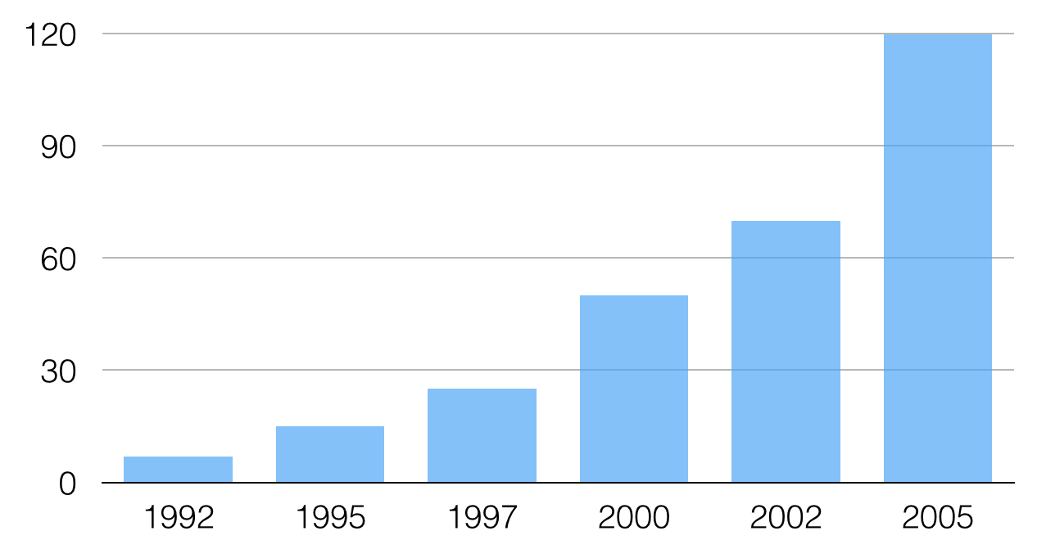
Watt per cm² in microprocessors

Slide 23
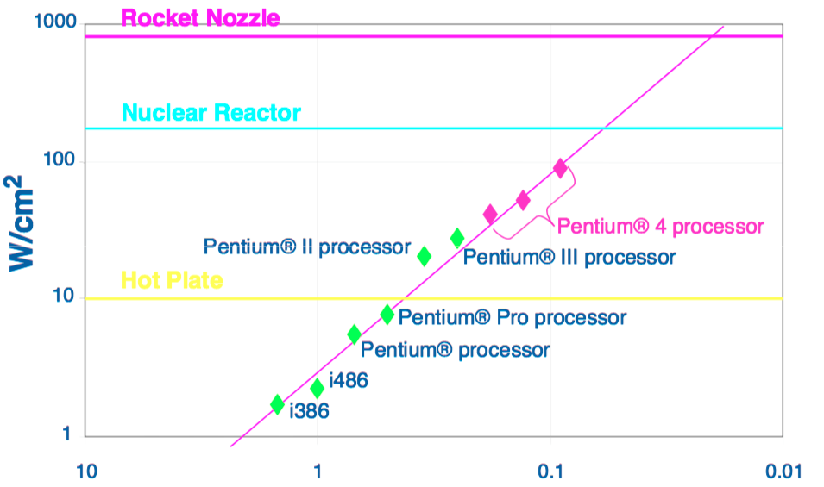
Watt per cm^2 in microprocessors
Taylor, 2009

Slide 24
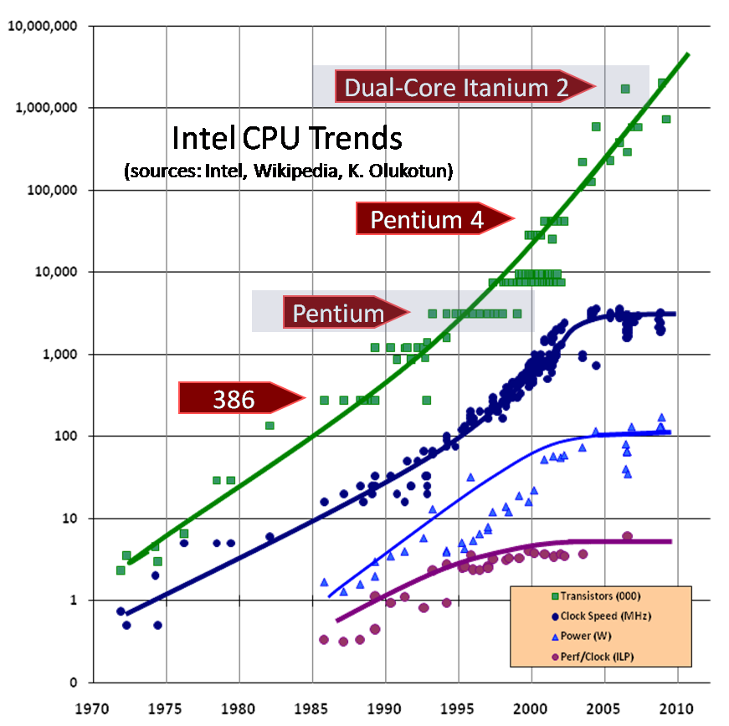

Slide 25
What is parallelism
What is concurrency
Notes:
<16m

Slide 26
Parallel computing types
Bit level - 8, 16, 32, 64
Instruction level (CPUs)
Data level (SIMD)
Task level
Give an example for
Parallelism without concurrency
Concurrency without parallelism
Notes:
< 18
20m

Slide 27
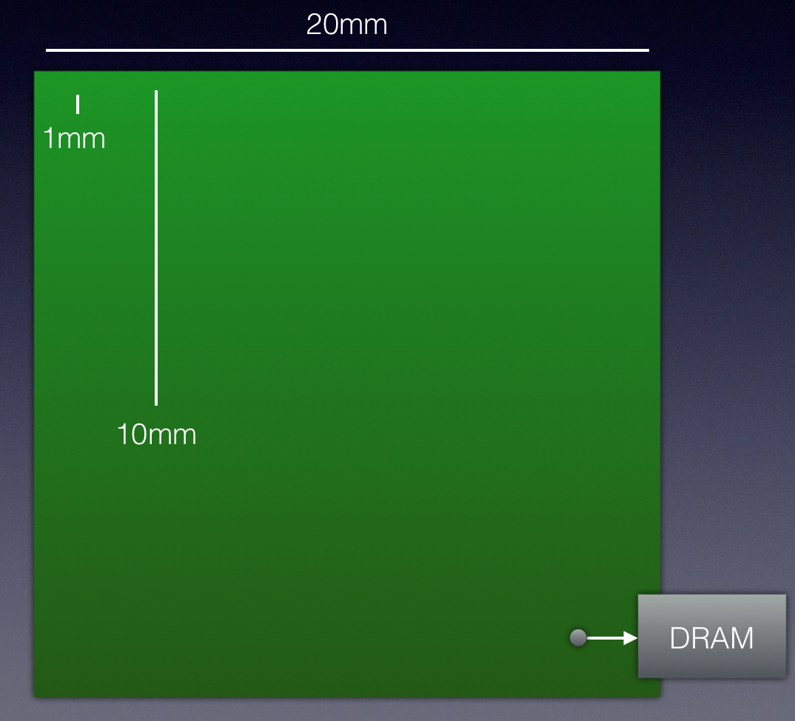
2500x single thread improvement for the last 30 years
~30x single thread improvement for the next 50 years
Single thread gets 2% to 15% per year
Multithread ~75% per year
“ALUs are like kids – easy to make, hard to feed”
What about locality?
Moving 64 bytes 1mm costs more than doing FMAD
Bill Dally, NVIDIA
Notes:
<22

Slide 28
Performance = Parallelism
Efficiency = Locality
(serial or parallel)

Slide 29
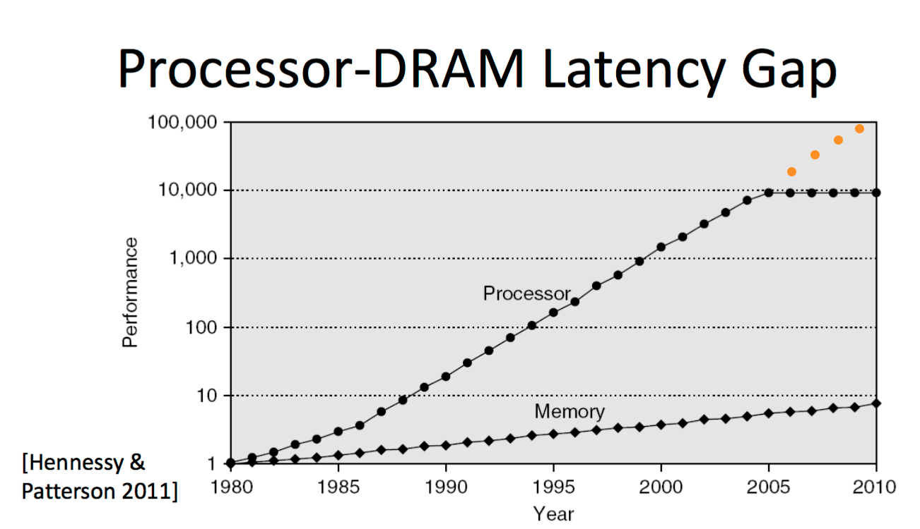
THE WORLD IS NOT FLAT
OOP is a denial of that
So are all most of the high-level languages like Python, Ruby, Go, Haskell, Java, C#
The only purpose of every program is to convert one data into another
OOP hides the data from you
OOP was invented back in the days when the memory was as fast as the CPU
1996 L1 cache – 181ns
2004 L1 cache – 1ns
2020 L1 cache – 1ns
Check ”Data oriented Design” by Mike Actor, Cpp Con 2014
Later this month – “OOP is dead, long live Data Oriented Design”, Cpp Con 2018, Stoyan Nikolov

Slide 30
CPU cycle 0.25 seconds
L1 cache reference 1 second
L2 cache reference 14 seconds
Main memory reference 3.3 minutes
Send 1K bytes over 1 Gbps network 5.5 hours
Read 4K randomly from SSD >3 days Read 1 MB sequentially from memory >5 days Round trip within same datacenter Week and a half Read 1 MB sequentially from SSD Almost a month

Slide 31
Past
Present
Make a complex app. It is hard.
As time goes by, it gets faster
Profit
It is easy to make complex app
Use ComplexApp.JS
Doesn’t get faster as time goes by
The difference now is how fast a program is
Hardware, not software is defining the trends in the IT industry
For example, real time raytracing
Mainstream software always plays catch-up due to many reasons (compatibility, economic, etc.)
Sometimes, it takes many years (SSE)
Notes:
<26

Slide 32
Concurrency is the next revolution in how we write software. The vast majority of programmers today don't grok concurrency, just as the vast majority of programmers 15 years ago didn't yet grok objects
Herb Sutter, 2005

Slide 33
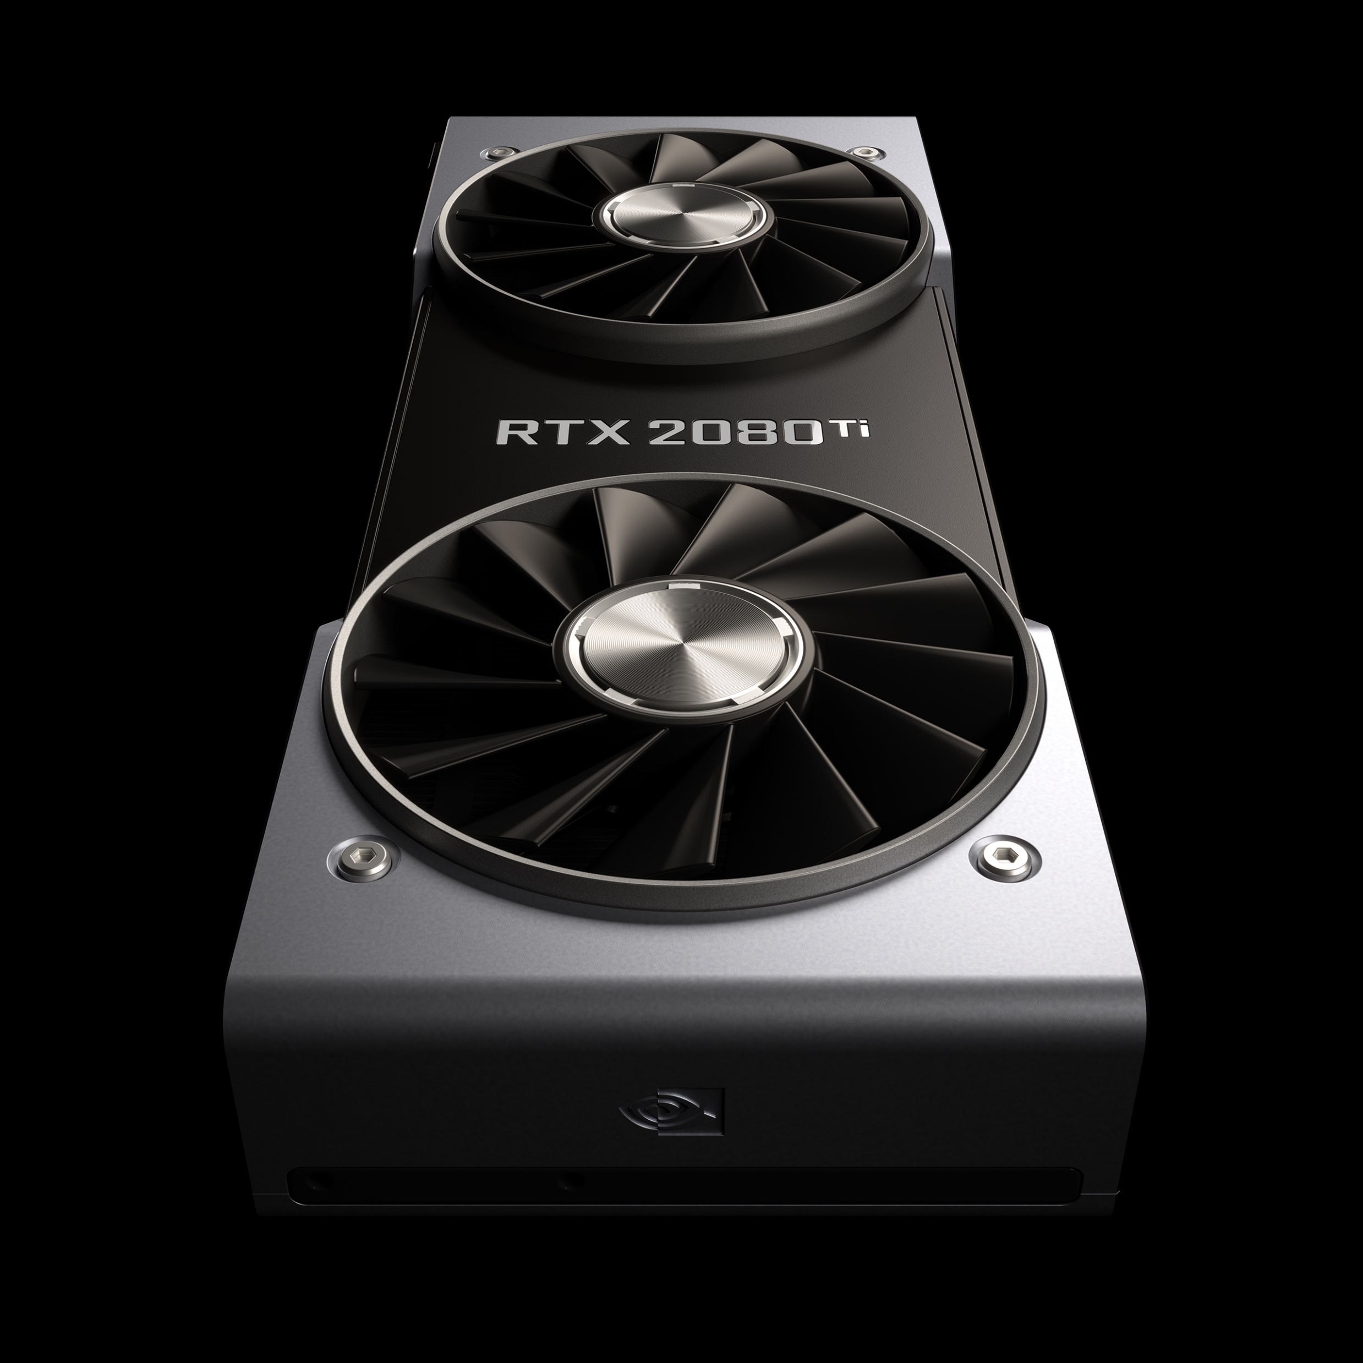
GPUs
If you know (a little) more about the problem, you can design a better solution
For example, quick sort is good algorithm for sorting numbers ~O(nlog(n))
But if you know that the numbers are million integers between 0 and 10, you can do better (counting sort = O(n))
GPUs assume that you have embarrassingly parallel problem
This is a problem, that is trivial to design a massively parallel solution
Give you more control over the cache (locality)
Notes:
~27

Slide 34
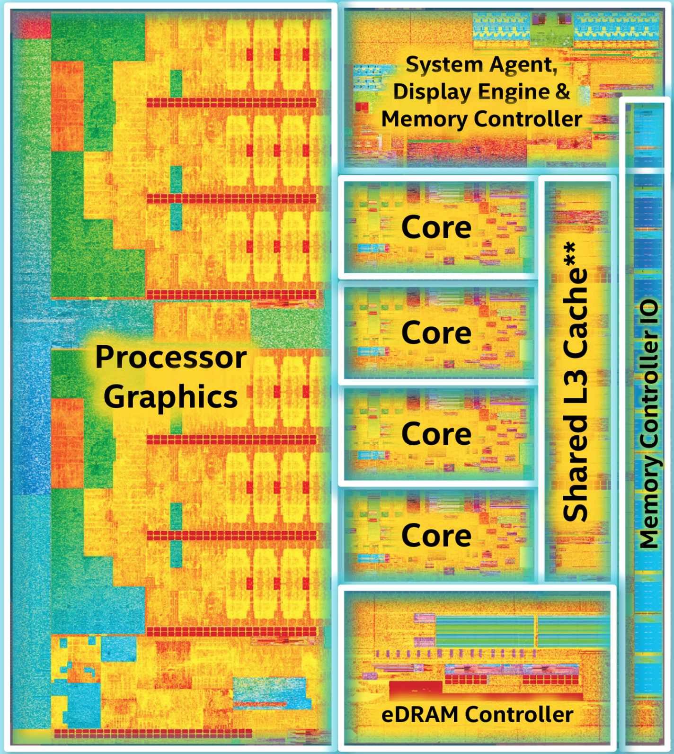
Notes:
<30

Slide 35
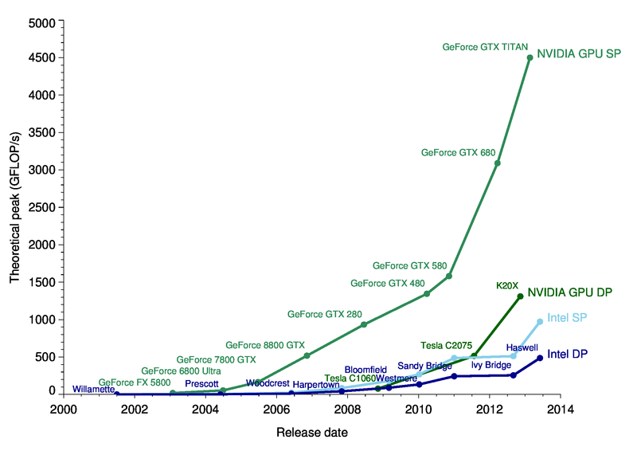

Slide 36
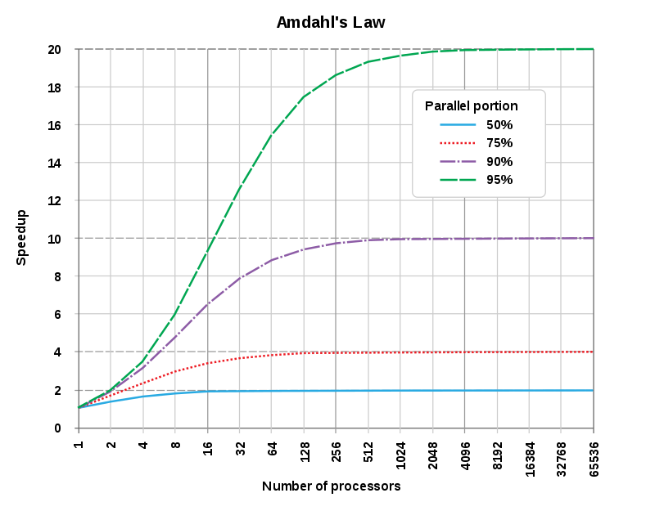

Slide 37
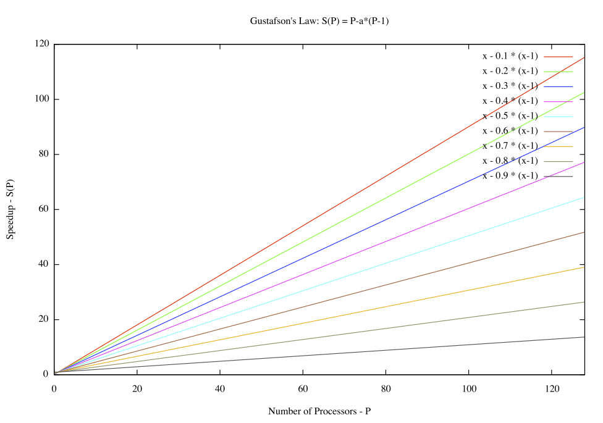
Notes:
~33

Slide 38
HOW?

Slide 39
CPU
GPU
Low level language
C/C++/Rust/D, maybe Swift
Data level parallelism
Auto vectorization
SIMD intrinsics
SIMD libraries
Task level parallelism
Multi thread
Multi process
Pick your poison
Hardware and API vendor
All have pros and cons
GPUOpen.com
Vendor specific frameworks
CUDA, Metal
OpenACC

Slide 40
General purpose GPU applications
If the only tool that you have is a GPU, everything looks like an embarrassingly parallel problem
APIs
Based on C99
Server-client like (CPU-GPU)
Data- and task- parallel models
Abstracts the hardware specifics
You have to be fluent in C
Notes:
~34

Slide 41




Only NVIDIA GPUs, runs on Windows, Linux and macOS
Runs on AMD and Intel, somewhat on NVIDIA, deprecated by Apple, less flexible than CUDA
Not officially supported on Apple operating systems, rather new
Runs on Intel, NVIDIA, AMD, Apple GPUs, but available only on Apple operating systems

Slide 42
PARALLEL PROGRAMMING IS EASY*
CPU
GPU
void foo(float* a, float* res, int cnt)
{
#pragma omp parallel for
for (int i = 0; i < cnt; ++i)
res[i] = sqrt(a[i]);
}
kernel void foo(float* a, float* res, int cnt)
{
const int i = get_global_id(0);
if (i > cnt) return;
r[i] = sqrt(a[i]);
}
*as long as you don’t need it to be fast

Slide 43


Slide 44
REFERENCES
"Parallel Programing Concepts", Peter Troger, HPI
OpenCourseWare 6.172, MIT
How to Write Fast Numerical Code, Markus Puschel, ETH Zurich
Princeton, Computer Architecture, D. Wentzlaff
"Programming Massively Parallel Processors”, Stanford
lighterra.com
Andrew S. Tanenbaum (books)
C++ Concurrency in action (book)
The Art of Concurrency (book)
High Performance Computing (Charles Sevarance, Kevin Dowd) (book)
Programming massively parallel processors (book)
OpenCL Programming Guide (book)
Compilers: Principles, Techniques, and Tools (book)
What every programmer should know about memory (paper)
Colin Scott, Interactive Latencies
Pixabay
Pexels
More references in the slides

Slide 45
THANK YOU FOR YOUR TIME!
Key takeaways:
Start with the Why Performance is more important than ever
Performance = Parallelism

